Slide 1
Histories of Immigration in Canada
Canada 262: A Short History of Here
Prof. Heidi Bohaker
Guest Lecturer: Chandra Murdoch
March 7 2018

Slide 2
Who has been able to set down roots in Canada?
Some of the specific Government policies that have shaped the demographics that we see in Canada today
Gender as an important category in Canadian migration history and family history
Resistance from groups of migrants affected by these policies

Slide 3
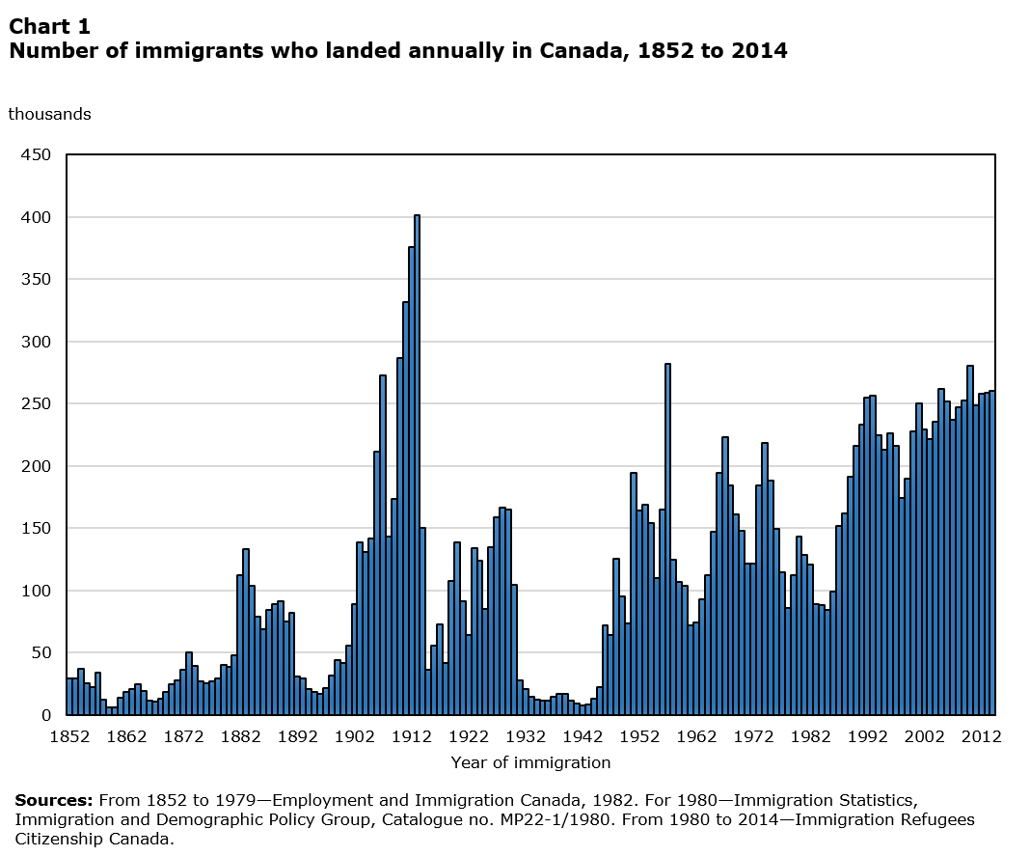

Slide 4
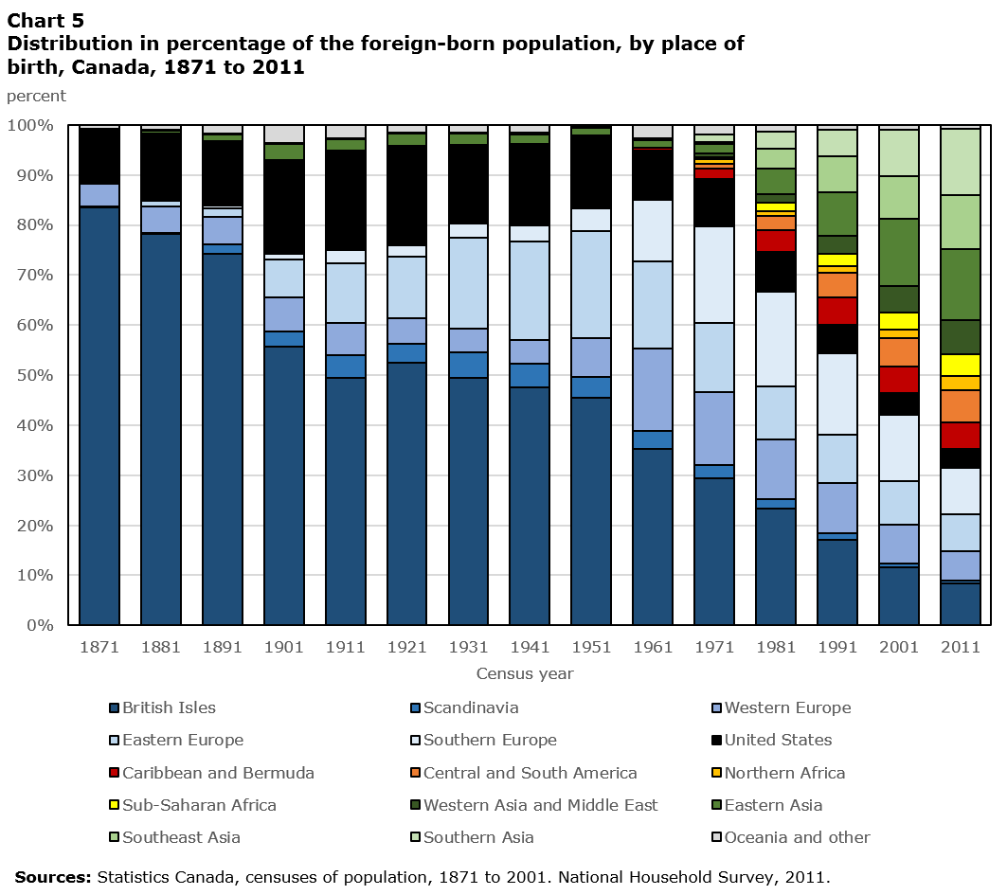

Slide 5
Pre-Confederation Migration Patterns: The need for women and labourers
Filles du Roi (1663-1673)
Loyalist Immigration
Irish Immigration
1825-1845: 425,000 migrants from Ireland
1847: 100,000 Irish famine migrants
British Columbia
Assisted Migration for White women

Slide 6
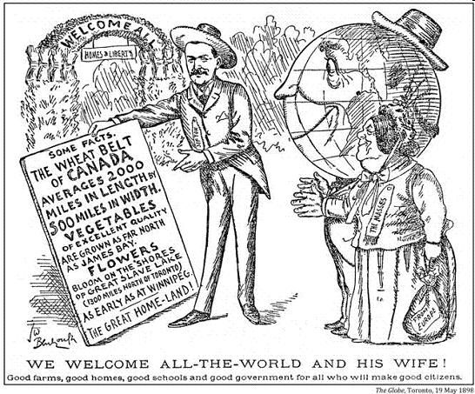
Settlement on the Prairies
Dominion Lands Act 1872
160 acres of land offered to settlers
Massive Propaganda Campaign in British Isles for Farmers to Immigrate

Slide 7
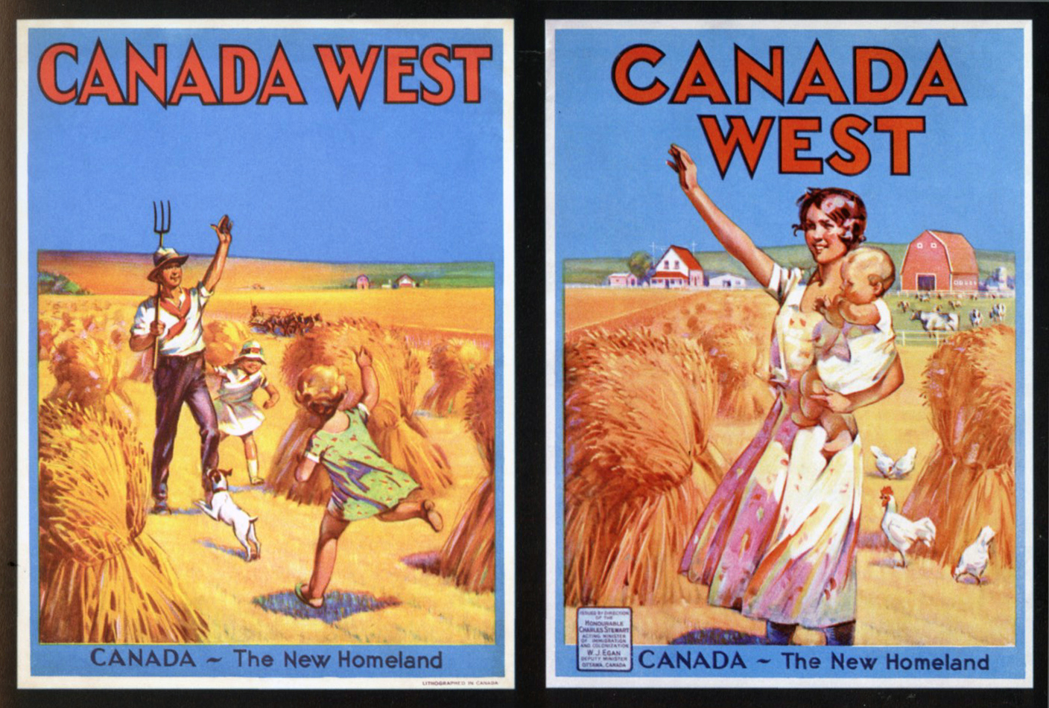

Slide 8
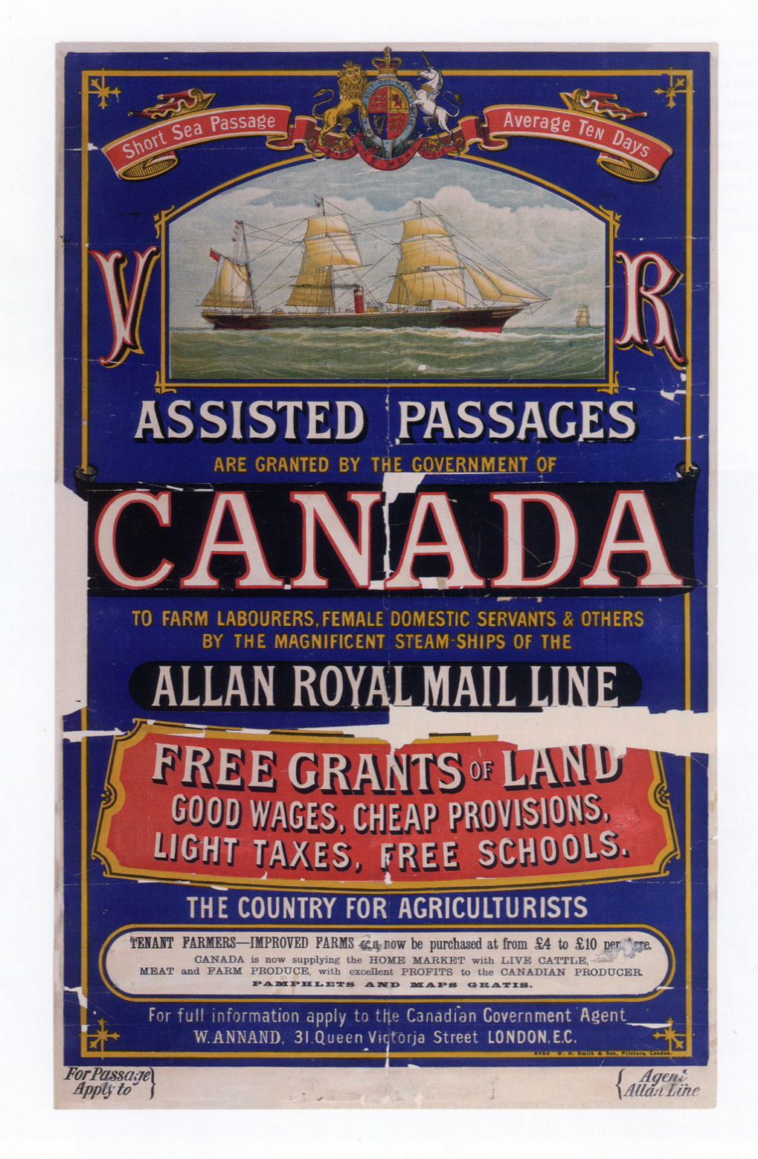
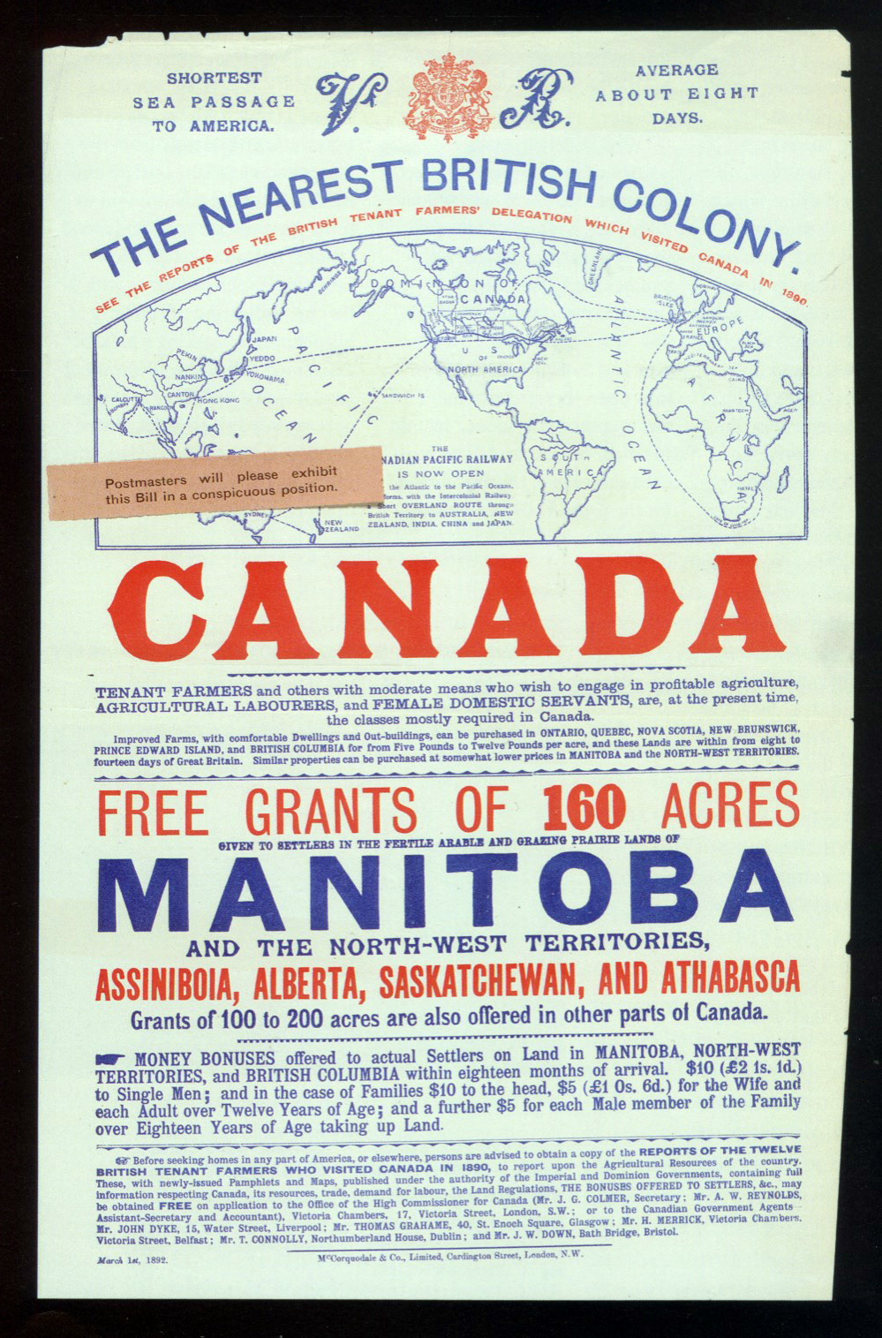
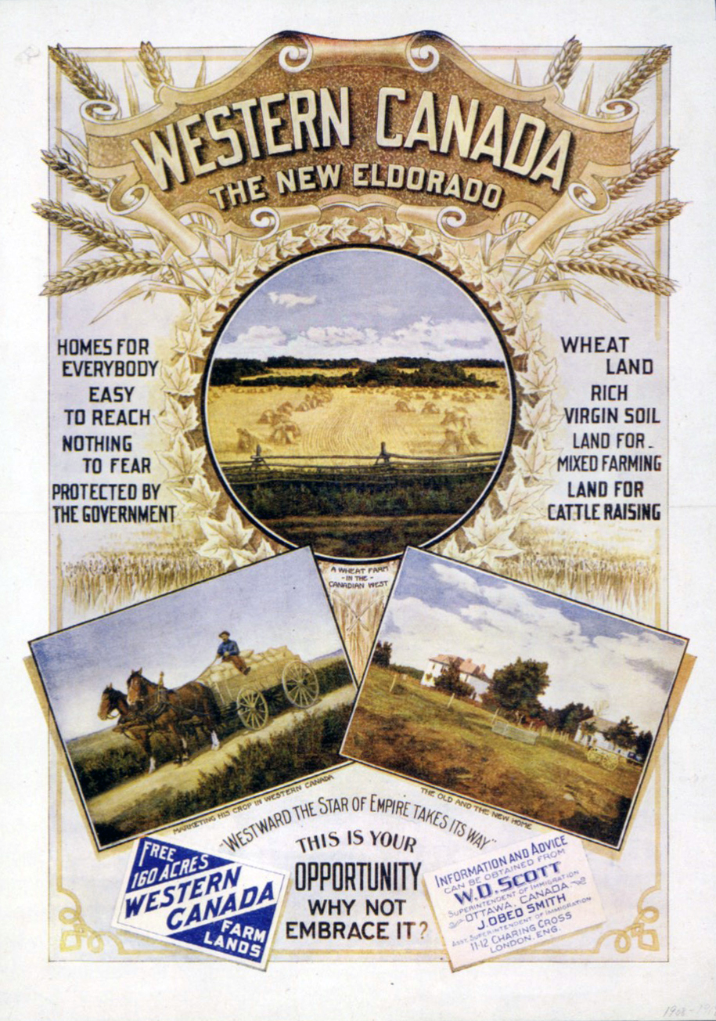

Slide 9
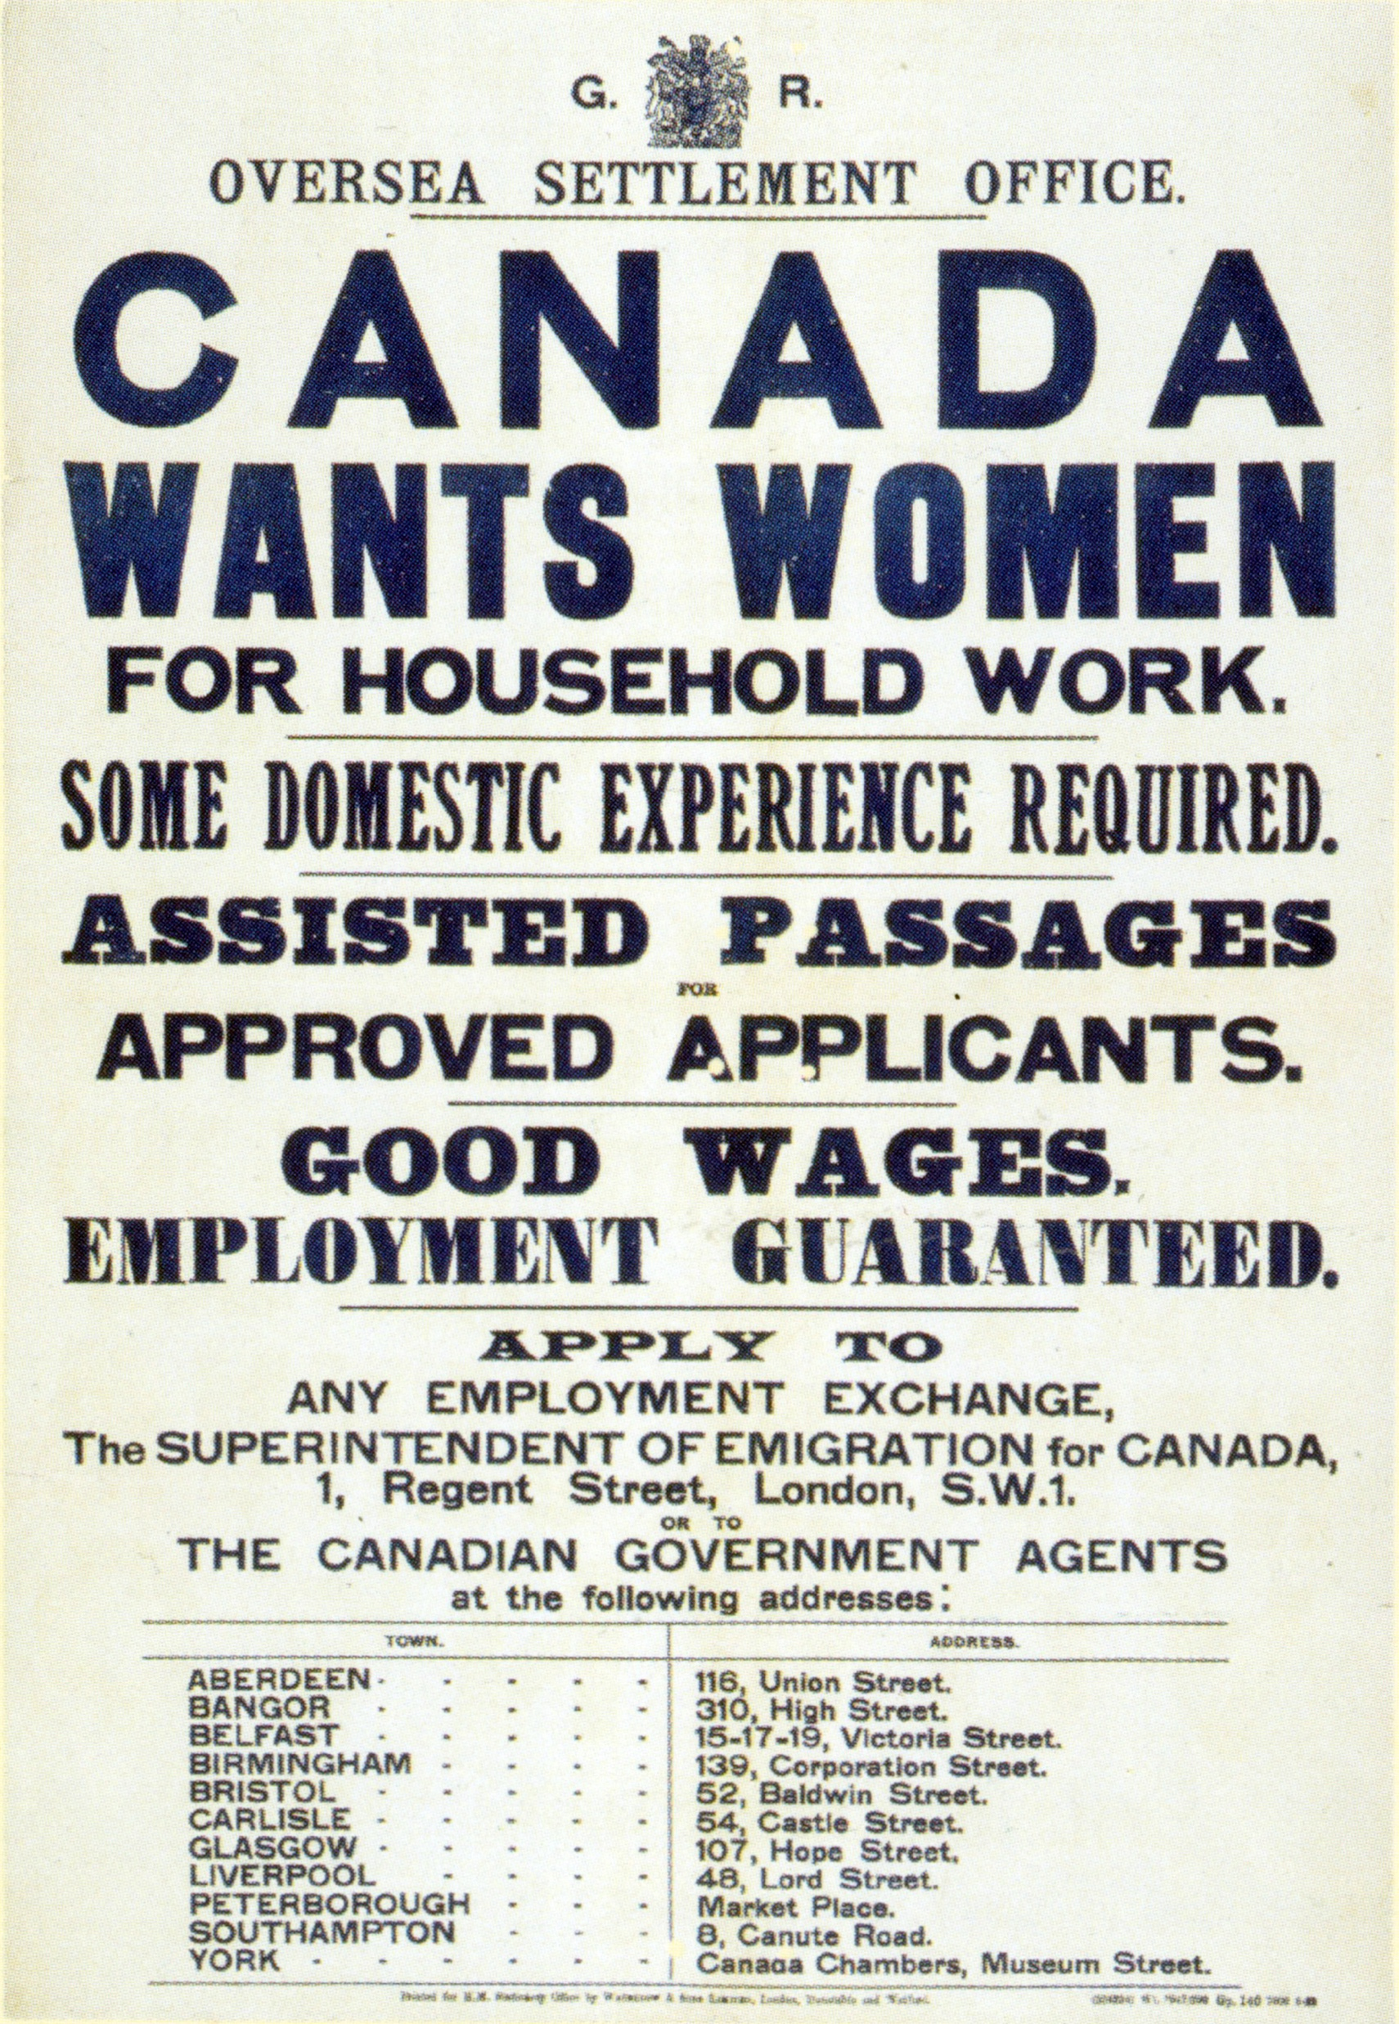

Slide 10
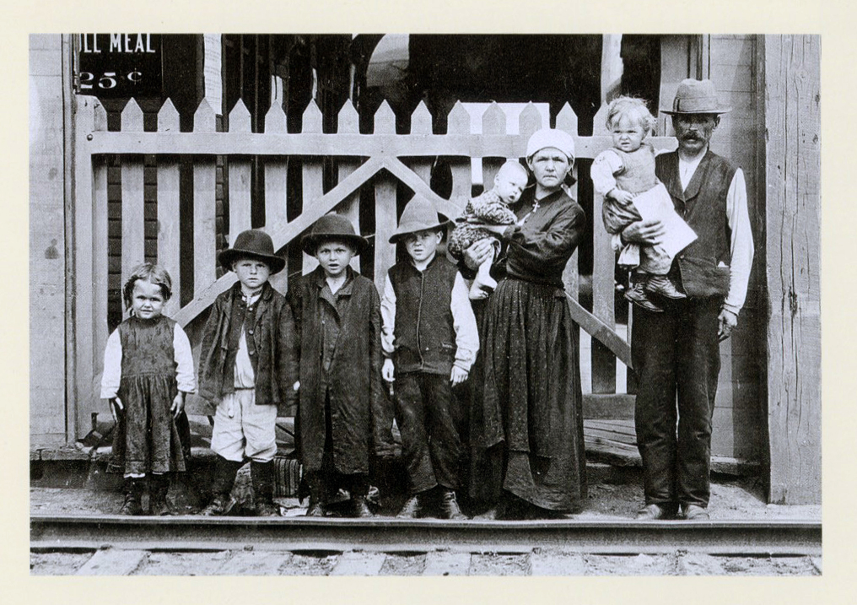
Promotion of Hungarian, Ukrainian, and Mennonite Immigration
Clifford Sifton- Minister of Interior 1896-1905
After economic recession of 1873-1896
“a stalwart peasant in a sheep-skin coat, born on the soil, whose forefathers have been farmers for ten generations, with a stout wife and a half dozen children, is a good quality.”
-Sir Clifford Sifton, “The Immigrants Canada Wants,” Maclean’s Magazine, April 1, 1922, 16.

Slide 11
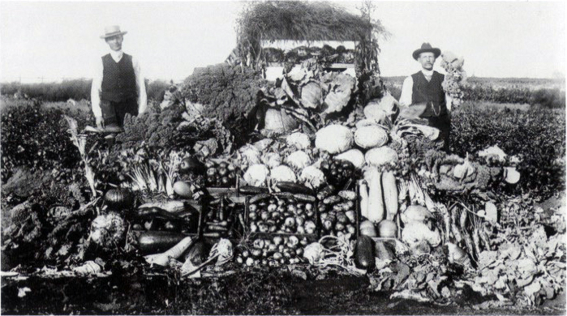

Slide 12
Imperial Order Daughters of the Empire
“We view with alarm the continuous and rapid influx of Negro settlers… this immigration will have the immediate effect of the discouraging white settlement in the vicinity of the Negro farms and will depreciate the value of all holdings within such areas.”
IODE Alberta Chapters to F. Oliver, Edmonton, 31 March 1911, File 72552 Pt 3.
IODE Rose Ball at the King Edward Hotel, Toronto,
on 28 February 1911, photographed by F. W. Micklethwaite.

Slide 13
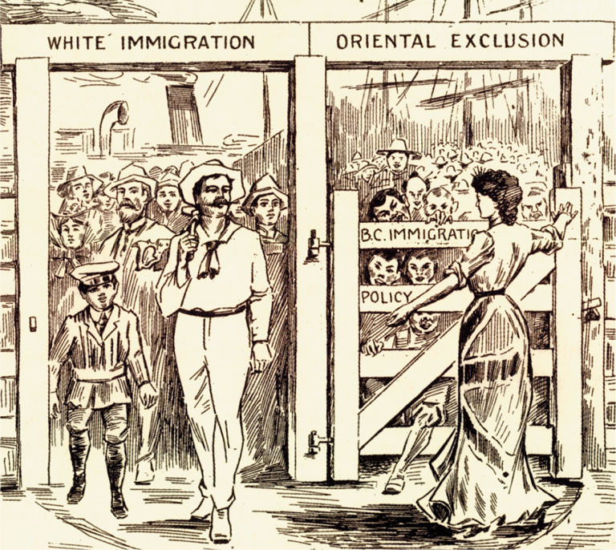
Era of Explicit Exclusion
Head Tax 1885
Chinatown Riots 1907
Hayashi-Lemieux Agreement 1908
1914 Komagata Maru
Chinese Exclusion Act 1923-1947

Slide 14
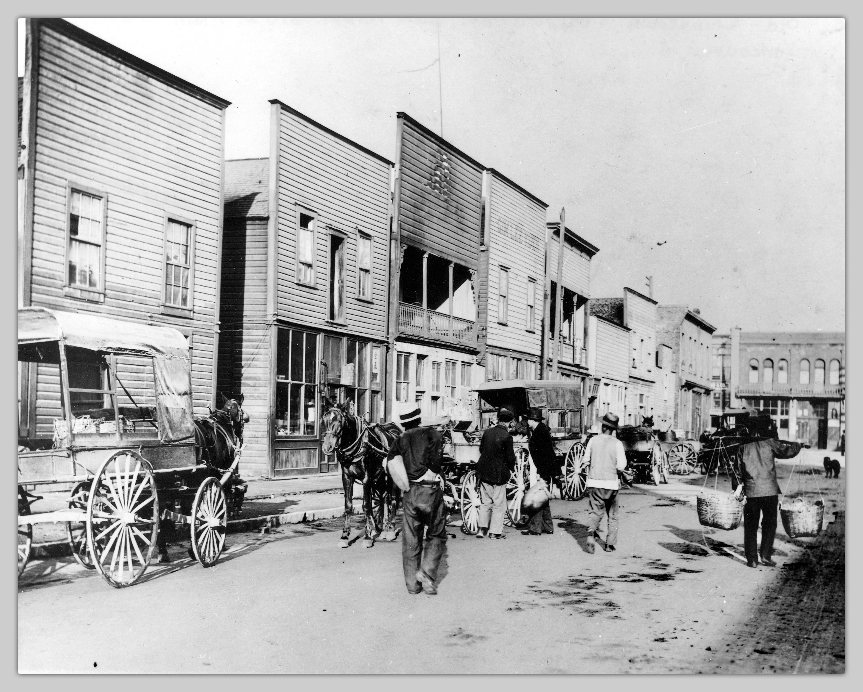
British Columbia Challenges to Immigration Policy
Vancouver’s Chinatown 1905
1885
-BC attempts to ban Chinese Immigration
-Macdonald passes Head Tax
1907
-Asiatic Exclusion League forms (With support from labour organizations, mayor and city councillors members)
-Chinatown Riots- 4000—8000 (est.) destroy windows, property in Chinese and Japanese businesses
1908
-Hayashi-Lemieux Agreement
-Continuous Journey legislation
Source: Timms, P. (1904). Old Chinatown Dupont St. at Main St. 5a.m., Vancouver, B.C.
UBC, Open Collections, Chung Collection

Slide 15
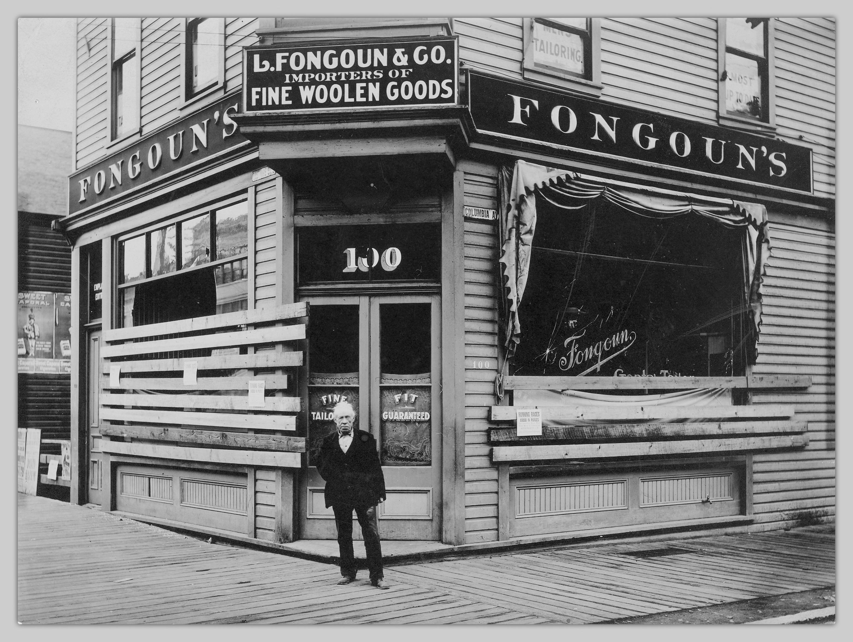
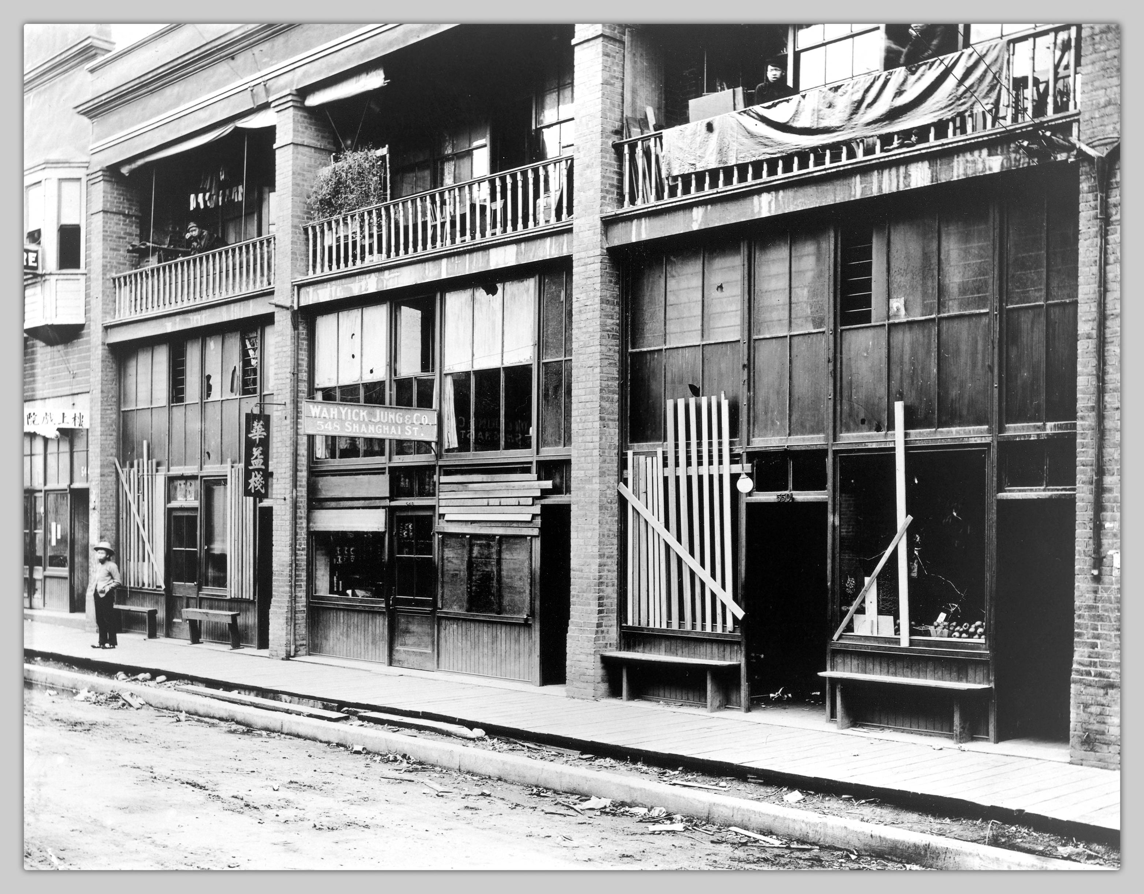
Aftermath of 1907 Chinatown Riots
Source: [unknown]. (1907). [Shanghai Alley after
Chinatown 1907 riots, Vancouver, B.C.]
UBC, Open Collections
Source: [unknown]. (1907). Hastings Street and Columbia Street, southeast corner after anti-oriental riots of 1907.] UBC Open Collections

Slide 16
Komagata Maru, 1914
-Challenge to Continuous Journey Legislation orchestrated by Sikh merchant Gurdit Singh Sirhali
-Charters Japanese vessel with 376 prospective Punjabi immigrants (Sikh, Muslim and Hindu)
-Remained in harbour of Vancouver for 2 months while case was tried in provincial court, escorted out of harbour July 23, 1914
-Important flashpoint not just for Canadian history of migration, but also in Indian history of anti-colonialism
Source: Library and Archives Canada, HMCS Rainbow and the Komagata Maru, July 1914 in Vancouver harbour. C 45675

Slide 17
Wartime and Depression Years
1923 Chinese Immigration Act (Chinese Exclusion Act)
1930 Order in Council prohibits “any immigrant of any Asiatic race”
1939 SS St. Louis
-937 Jewish Refugees from Nazi Germany, turned away by Cuba, US and Canada
1941-1949 Internment of Japanese Canadians
-21,000 Japanese Canadians (14,000 born in Canada) sent to internment camps

Slide 18
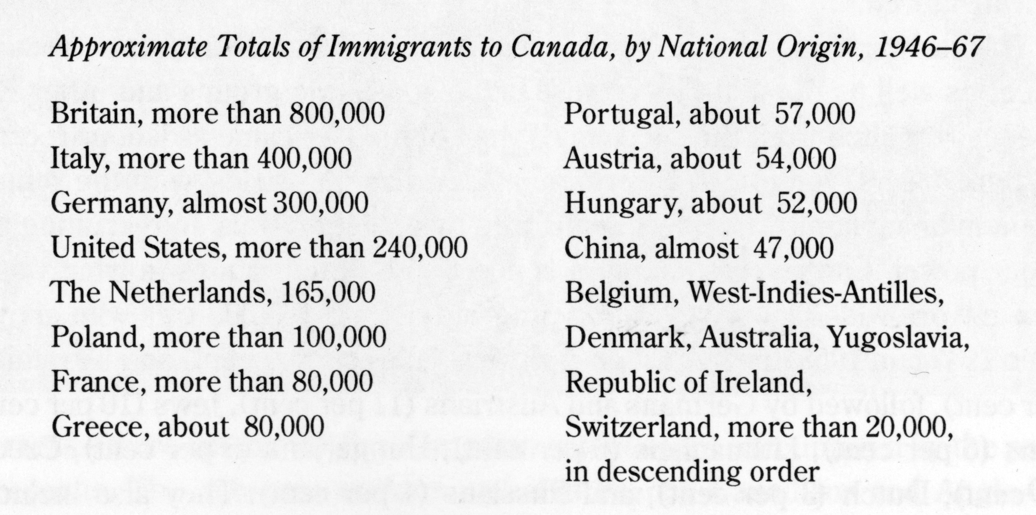
Post War Boom in European Immigration
Displaced persons- 186,154 come between 1947-1952
Source: Iacovetta, Franca. Gatekeepers: Reshaping Immigrant Lives in Cold War Canada (Toronto: Between the Lines Press, 2006)

Slide 19
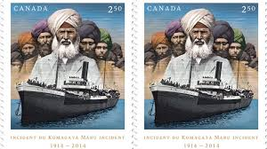
End of Explicit Exclusions
-Changing international ideas of race after horrors of Nazi concentration camps
-Sikh community wins right to vote in federal and provincial election 1947
-Pressures Government, small Immigration quotas set 1951 for India, Pakistan, Sri Lanka
-Chinese community successfully pressures government to repeal Chinese Exclusion Act 1947
-Cold War concerns of blocking Communist sympathizers structure Immigration policy

Slide 20
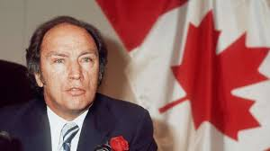
Bi and Bi commission and Multiculturalism
1963 Commission on Bilingualism and Biculturism
Also tasked with investigating role of other cultures in Canada
Recommends adopting policy of Multiculturalism
Pierre Elliot Trudeau adopts Multiculturalism as State Policy 1971
Multiculturalism Act passed 1988

Slide 21


Slide 22
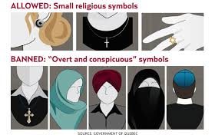
Quebec Charter of Values
2013 proposed by Parti Quebecois leader Pauline Marois
Officially a policy of “neutrality”
Effectively targets visible
religious minorities
-Defeated in 2014 election,
ongoing tensions in Quebec

Slide 23
How did such a big shift occur?
-Third World Decolonization movements
-Civil Rights Movement in the United States
-1951 Refugee Convention (Geneva Convention)
-International movement to recognize Human Rights
-In Ontario, black organizing instrumental in establishing Ontario Human Rights Commission 1961
-By 1960 all provinces have anti-discrimination laws for housing and labour

Slide 24
Changes to Canadian Immigration Act
1962
Immigration Act no longer contains references to race, ethnicity or geographical origin
1967
Points-based system is adopted
-education level
-age
-language proficiency
Shift towards colour blind language- definite move towards encouraging professional classes to immigrate
Still more immigration offices in European countries

Slide 25
Split in Immigration Pathways
Points-based system for professional classes
Temporary workers:
Caribbean Domestic Scheme 1955
Case of “Seven Jamaican Mothers” 1975
Foreign Domestics Program 1981
Live-in-Caregiver Program

Slide 26
Temporary Agricultural Workers Programs
1966 –Caribbean Seasonal Agricultural Workers Programs
NO path to citizenship
1973 – Non-Immigrant Employment Authorization Program
Evolves into contemporary system
-streams for Agricultural workers
-other unskilled labour positions

Slide 27
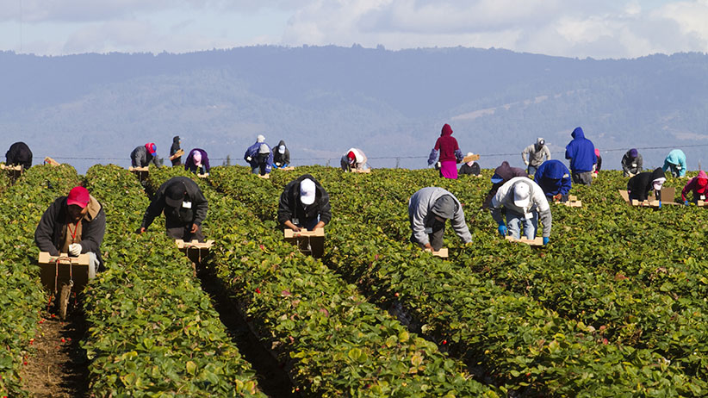
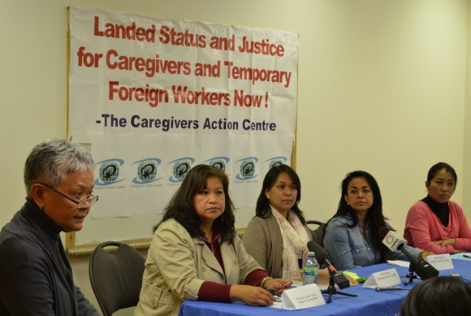
Contemporary Immigration Landscape
Temporary Foreign Worker Programs
Points system geared
to professional class

